Slide 1

PowerPoint Templates provided by PresentationPoint.com
Software solutions for digital signage and data driven presentations
www.PresentationPoint.com

Slide 2
COPYRIGHT NOTICE:
You are allowed to use these templates in your own organization and modify them as you like. You cannot sell or give them to others. Instead, direct them to PresentationPoint.com to download their own copy.

Slide 3
USING THIS TEMPLATE FOR DIGITAL SIGNAGE?
Check out iPoint
THE POWERPOINT DIGITAL SIGNAGE SOLUTION

Slide 4
NEED TO CONNECT THIS TEMPLATE TO DATA?
Check out DataPoint
OUR POWERPOINT
ADD-ON FOR DATA

Slide 5
WANT TO ADD WEATHER AND NEWS TO YOUR TEMPLATE?
Try Dynamic Elements
POWERPOINT ADD-ON
FOR NEWS AND WEATHER

Slide 6
WANT TIMERS & CLOCKS
ON YOUR TEMPLATE?
Try Dynamic Time
POWERPOINT ADD-ON FOR CLOCKS, TIMERS AND COUNTDOWNS

Slide 7



CELEBRATE WITH A THREE COURSE DINNER.
SATURDAY 14 FEB
YOURWEBSITE.COM

Slide 8

ALL YOU NEED IS
LOVE
20% OFF ON ALL BAKERY PRODUCTS

Slide 9


SEND GIFTS ON THIS
FREE SHIPPING
YOURWEBSITE.COM

Slide 10


VALENTINES
PARTY
14 FEB
YOURWEBSITE.COM

Slide 11

VALENTINES
SALE
UP TO 50% OFF
YOURWEBSITE.COM

Slide 12

SEND ROSES ON THIS
VALENTINES DAY
BUY ONE GET ONE FREE
YOURWEBSITE.COM

Slide 13


SAY IT WITH DINNER THIS
3 COURSE DINNER FOR 2 STARTING AT $20
BOOK NOW

Slide 14

happy
VALENTINES DAY
20% OFF
ON EVERYTHING

Slide 15

LO
VE
VALENTINES DAY DINNER
Starting at $30
YOURWEBSITE.COM

Slide 16


DINNER FOR TWO
$149 PER COUPLE
BOOK NOW

Slide 17
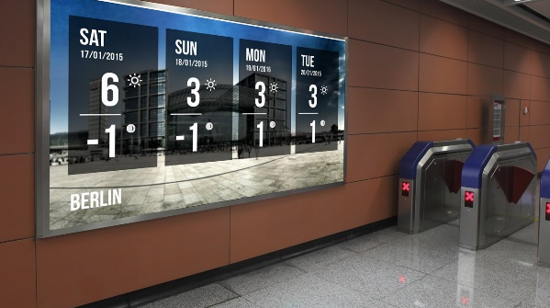
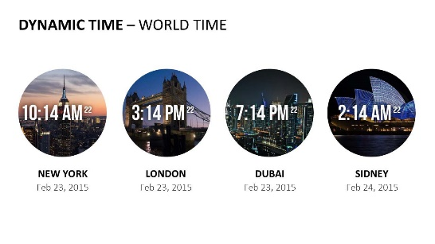


Do More With PresentationPoint Products
Real-time weather and forecasts
Add a clock or countdown to your presentations
Live RSS feed in your PowerPoint
Notes:
17

