Slide 1
PowerPoint Templates provided by PresentationPoint.com
Software solutions for digital signage and data driven presentations
www.PresentationPoint.com

Slide 2
COPYRIGHT NOTICE:
You are allowed to use these templates in your own organization and modify them as you like. You cannot sell or give them to others. Instead, direct them to PresentationPoint.com to download their own copy.

Slide 3
USING THIS TEMPLATE FOR DIGITAL SIGNAGE?
Check out iPoint
THE POWERPOINT DIGITAL SIGNAGE SOLUTION

Slide 4
NEED TO CONNECT THIS TEMPLATE TO DATA?
Check out DataPoint
OUR POWERPOINT
ADD-ON FOR DATA

Slide 5
WANT TO ADD WEATHER AND NEWS TO YOUR TEMPLATE?
Try Dynamic Elements
POWERPOINT ADD-ON
FOR NEWS AND WEATHER

Slide 6
WANT TIMERS & CLOCKS
ON YOUR TEMPLATE?
Try Dynamic Time
POWERPOINT ADD-ON FOR CLOCKS, TIMERS AND COUNTDOWNS

Slide 7
EVERY SUMMER HAS ITS OWN STORY

Slide 8
Sand And Sun, Summer Has Begun!

Slide 9
SAY
HELLO
TO
Summer

Slide 10
SHOP OUR
SUMMER
SALE

Slide 11
It's a smile, it's a kiss, it's a sip of wine... It's summertime!

Slide 12
Less Monday More Summer

Slide 13
PEACE
LOVE
AND
SUMMER

Slide 14
High Tides
Good Vibes

Slide 15
ARE YOU READY FOR SUMMER?

Slide 16
LIFE IS BETTER IN FLIP FLOPS

Slide 17
05
SUMMER SALE IS AROUND THE CORNER
Days

Slide 18
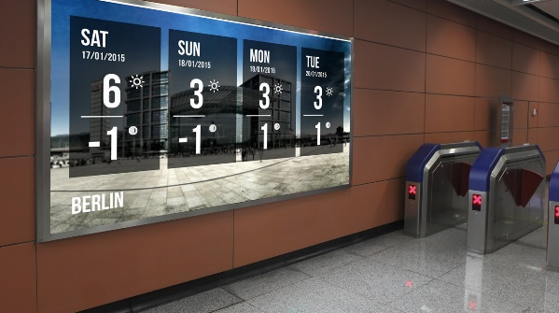
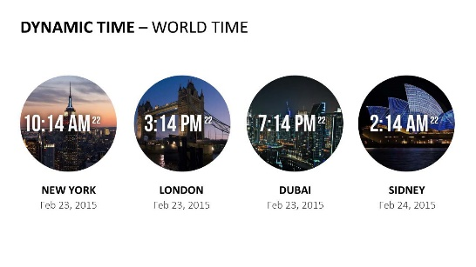
Do More With PresentationPoint Products
Real-time weather and forecasts
Add a clock or countdown to your presentations
Live RSS feed in your PowerPoint
Notes:
18

