Slide 1
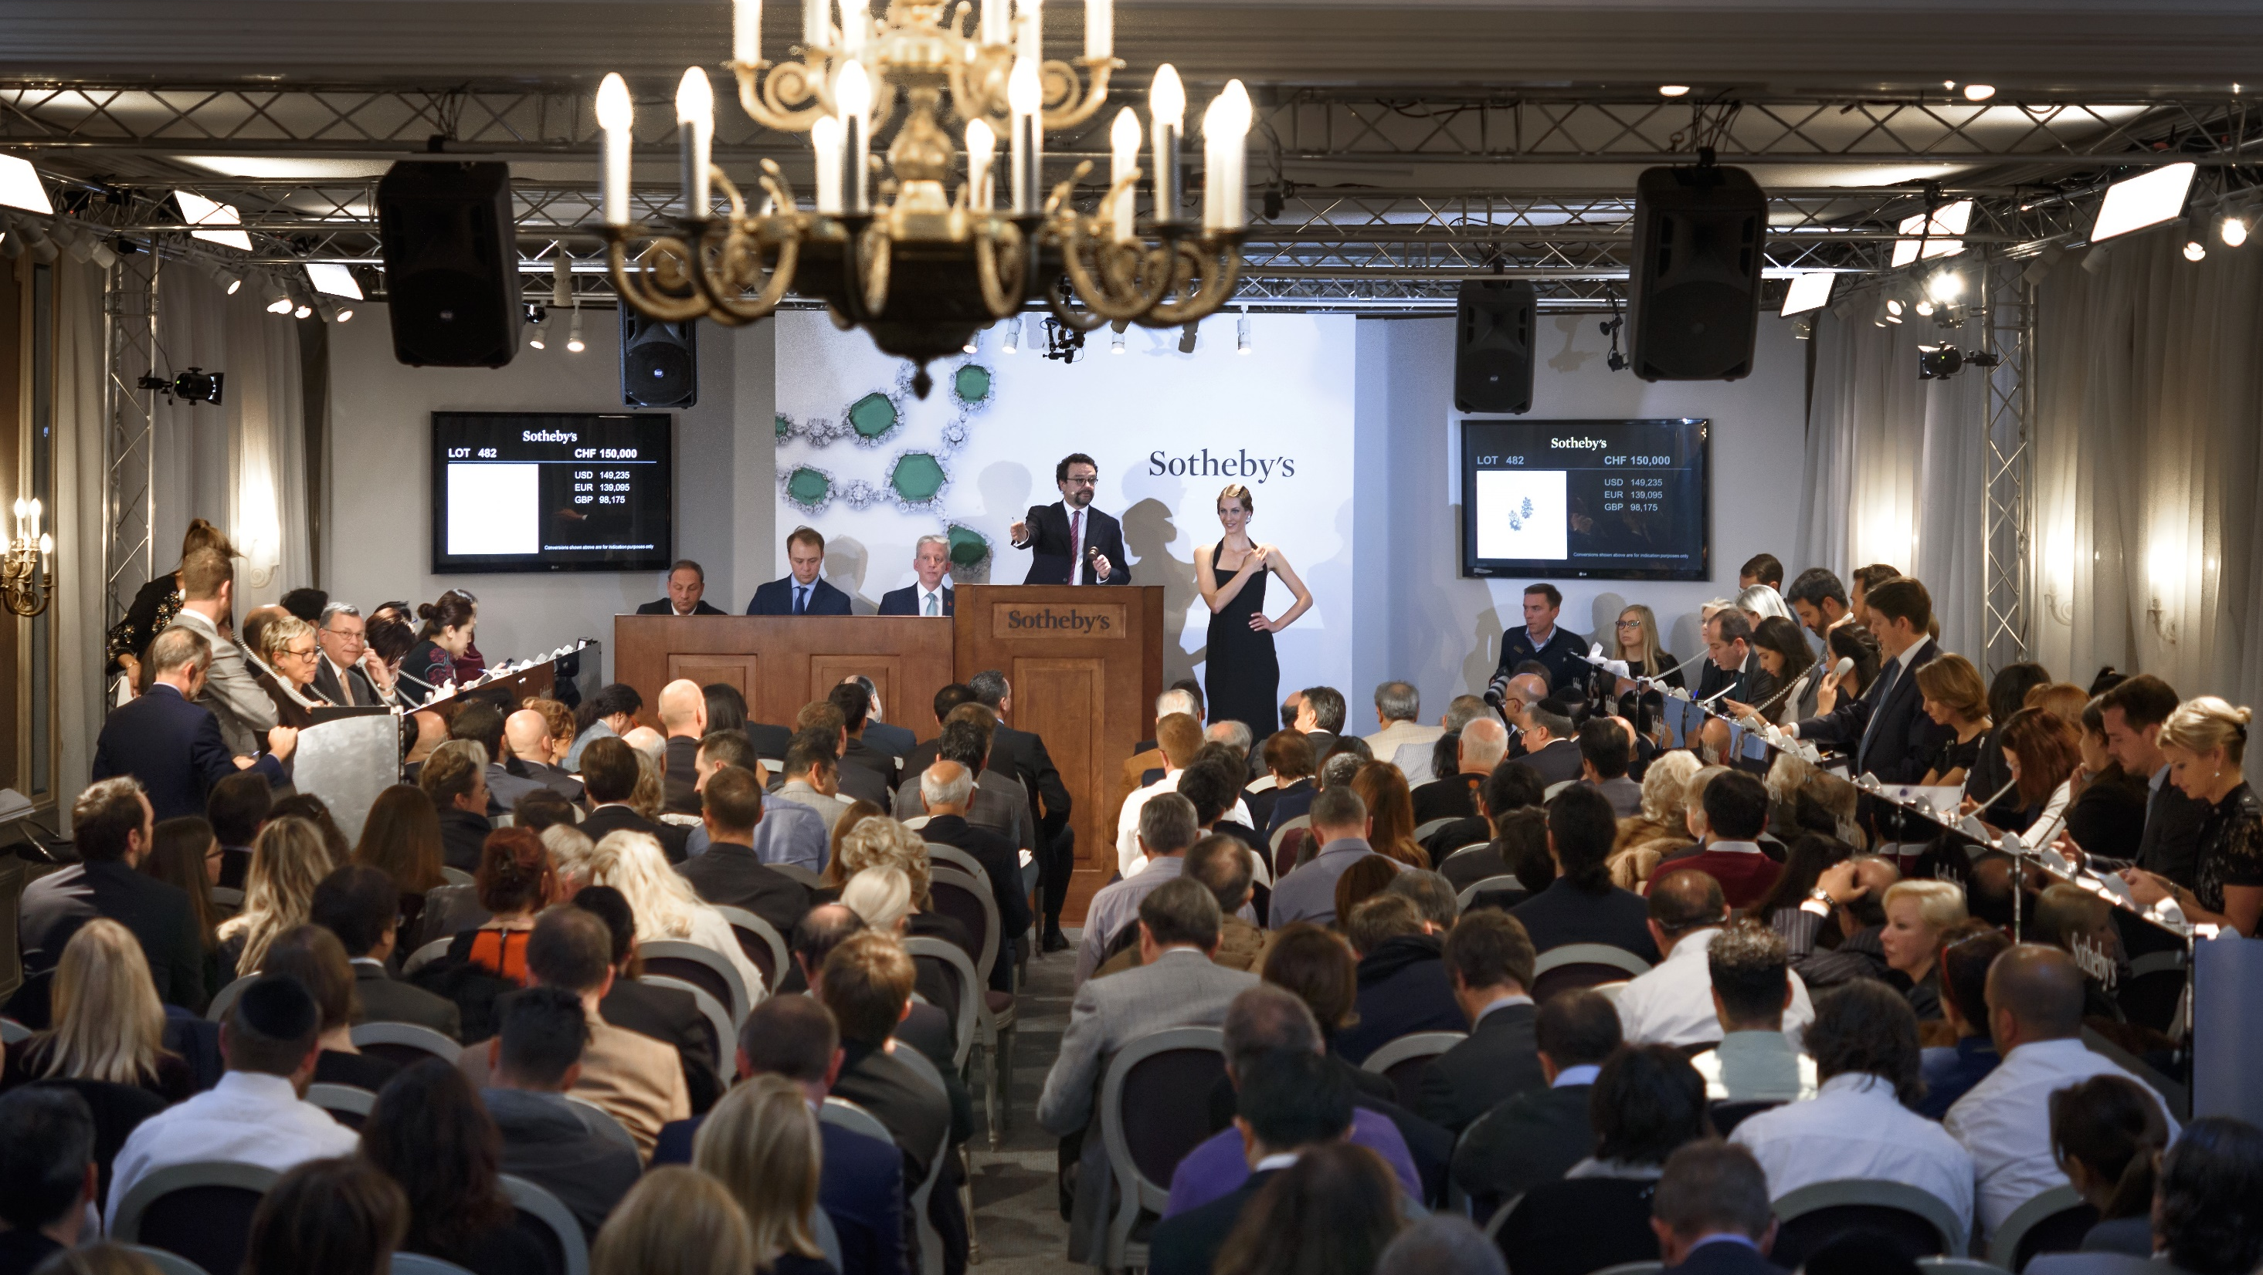
PowerPoint Templates provided by PresentationPoint.com
Software solutions for digital signage and data driven presentations
www.PresentationPoint.com

Slide 2
COPYRIGHT NOTICE:
You are allowed to use these templates in your own organization and modify them as you like. You cannot sell or give them to others. Instead, direct them to PresentationPoint.com to download their own copy.

Slide 3
USING THIS TEMPLATE FOR DIGITAL SIGNAGE?
Check out iPoint
THE POWERPOINT DIGITAL SIGNAGE SOLUTION

Slide 4
NEED TO CONNECT THIS TEMPLATE TO DATA?
Check out DataPoint
OUR POWERPOINT
ADD-ON FOR DATA

Slide 5
WANT TO ADD WEATHER AND NEWS TO YOUR TEMPLATE?
Try Dynamic Elements
POWERPOINT ADD-ON
FOR NEWS AND WEATHER

Slide 6
WANT TIMERS & CLOCKS
ON YOUR TEMPLATE?
Try Dynamic Time
POWERPOINT ADD-ON FOR CLOCKS, TIMERS AND COUNTDOWNS

Slide 7


ST. PATRICKS
CELEBRATIONS

Slide 8

ST. PATRICK'S FESTIVAL
3:00 PM
Monday

Slide 9

PARTY
GREEN
17 March – 5:00PM

Slide 10

MEGA SALE
ENJOY UP TO 50% OFF
YOURWEBSITE.COM

Slide 11

LET’S PARTY
17.03.19
YOURWEBSITE.COM

Slide 12

GREEN SALE
UP TO
60% OFF

Slide 13

Are You Prepared
To Party?
03 DAYS LEFT
YOURWEBSITE.COM

Slide 14

SALE
ENJOY UP TO 30% OFF
17.03.19

Slide 15

HAPPY
ST. PATRICKS DAY
FREE BEER!
YOURWEBSITE.COM

Slide 16

GET YOUR IRISH ON!
FREE BEER ON 17 MARCH
YOURWEBSITE.COM

Slide 17
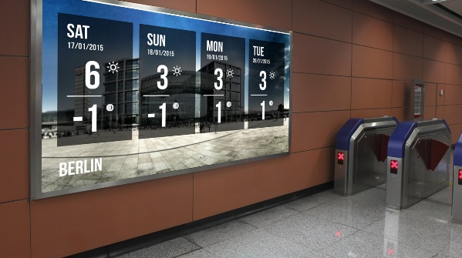
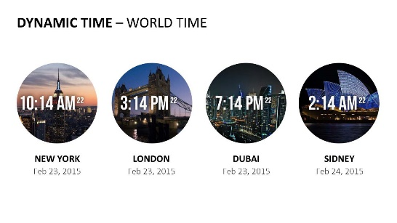


Do More With PresentationPoint Products
Real-time weather and forecasts
Add a clock or countdown to your presentations
Live RSS feed in your PowerPoint
Notes:
17

