Slide 1
PowerPoint Templates provided by PresentationPoint.com
Software solutions for digital signage and data driven presentations
www.PresentationPoint.com

Slide 2
COPYRIGHT NOTICE:
You are allowed to use these templates in your own organization and modify them as you like. You cannot sell or give them to others. Instead, direct them to PresentationPoint.com to download their own copy.

Slide 3
USING THIS TEMPLATE FOR DIGITAL SIGNAGE?
Check out iPoint
THE POWERPOINT DIGITAL SIGNAGE SOLUTION

Slide 4
NEED TO CONNECT THIS TEMPLATE TO DATA?
Check out DataPoint
OUR POWERPOINT
ADD-ON FOR DATA

Slide 5
WANT TO ADD WEATHER AND NEWS TO YOUR TEMPLATE?
Try Dynamic Elements
POWERPOINT ADD-ON
FOR NEWS AND WEATHER

Slide 6
WANT TIMERS & CLOCKS
ON YOUR TEMPLATE?
Try Dynamic Time
POWERPOINT ADD-ON FOR CLOCKS, TIMERS AND COUNTDOWNS

Slide 7
ARE YOU READY??
WORLDCUP
IS AROUND
THE CORNER

Slide 8
KEEP
CLAM
&
PLAY
SOCCER

Slide 9
EAT
SLEEP
SOCCER

Slide 10
6.8.17
COUNTDOWN BEGINS

Slide 11
No crowd.
No coaches.
No distractions. That is when champions are made.

Slide 12
IT'S HARD TO BEAT SOMEONE WHO NEVER QUITS.

Slide 13
12 DAYS
LEFT

Slide 14
GET
READY!

Slide 15
EVERYONE IS EXCITED FOR U17, ARE YOU?

Slide 16
3
2
1ST HALF

Slide 17
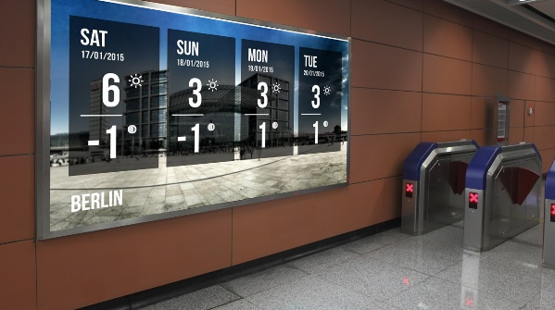
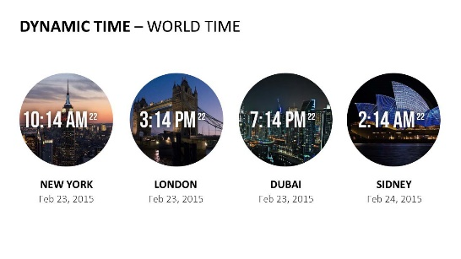
Do More With PresentationPoint Products
Real-time weather and forecasts
Add a clock or countdown to your presentations
Live RSS feed in your PowerPoint
Notes:
17

