Slide 1
PowerPoint Templates provided by PresentationPoint.com
Software solutions for digital signage and data driven presentations
www.PresentationPoint.com

Slide 2
COPYRIGHT NOTICE:
You are allowed to use these templates in your own organization and modify them as you like. You cannot sell or give them to others. Instead, direct them to PresentationPoint.com to download their own copy.

Slide 3
USING THIS TEMPLATE FOR DIGITAL SIGNAGE?
Check out iPoint
THE POWERPOINT DIGITAL SIGNAGE SOLUTION

Slide 4
NEED TO CONNECT THIS TEMPLATE TO DATA?
Check out DataPoint
OUR POWERPOINT
ADD-ON FOR DATA

Slide 5
WANT TO ADD WEATHER AND NEWS TO YOUR TEMPLATE?
Try Dynamic Elements
POWERPOINT ADD-ON
FOR NEWS AND WEATHER

Slide 6
WANT TIMERS & CLOCKS
ON YOUR TEMPLATE?
Try Dynamic Time
POWERPOINT ADD-ON FOR CLOCKS, TIMERS AND COUNTDOWNS

Slide 7
YOUR LOGO
Why pay more???
Your Text
+++ Newsticker +++ Newsticker +++ Newsticker +++ Newsticker +++ Newsticker +++ Newsticker +++Newsticker +++Newsticker +++Newsticker +++
Notes:
7

Slide 8
YOUR LOGO
Fresh
Mediterranean Feeling
Product information
2,39
3,99
Product description here
only
Product description here
Display promotions in real time using DataPoint
You can remove this note
Product description here
+++ Newsticker +++ Newsticker +++ Newsticker +++ Newsticker +++ Newsticker +++ Newsticker +++Newsticker +++Newsticker +++Newsticker +++
Notes:
8

Slide 9
YOUR LOGO
Way finding and information using DataPoint
You can remove this note
Store Manager Mr. Doe
Who am I?
Do you have any questions?
Please feel free to contact me or
The competent staff in our store.
Don‘t hesitate to ask me or customer information
+++ Newsticker +++ Newsticker +++ Newsticker +++ Newsticker +++ Newsticker +++ Newsticker +++Newsticker +++Newsticker +++Newsticker +++
Notes:
9

Slide 10
YOUR LOGO
15:30 - 16:00
Special 1 | Placeholdertext
15:30 - 16:00
Special 2 | Placeholdertext
Display events and product demonstrations using DataPoint
You can remove this note
15:30 - 16:00
Special 3 | Placeholdertext
+++ Newsticker +++ Newsticker +++ Newsticker +++ Newsticker +++ Newsticker +++ Newsticker +++Newsticker +++Newsticker +++Newsticker +++
Notes:
10

Slide 11
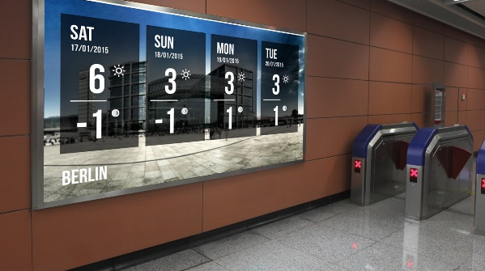
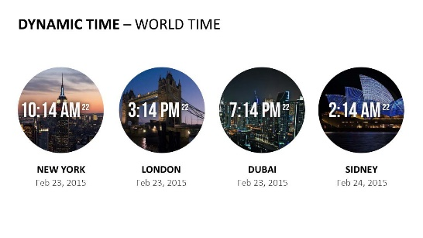
Do More With PresentationPoint Products
Real-time weather and forecasts
Add a clock or countdown to your presentations
Live RSS feed in your PowerPoint
Notes:
11

