Slide 1
PowerPoint Templates provided by PresentationPoint.com
Software solutions for digital signage and data driven presentations
www.PresentationPoint.com

Slide 2
COPYRIGHT NOTICE:
You are allowed to use these templates in your own organization and modify them as you like. You cannot sell or give them to others. Instead, direct them to PresentationPoint.com to download their own copy.

Slide 3
USING THIS TEMPLATE FOR DIGITAL SIGNAGE?
Check out iPoint
THE POWERPOINT DIGITAL SIGNAGE SOLUTION

Slide 4
NEED TO CONNECT THIS TEMPLATE TO DATA?
Check out DataPoint
OUR POWERPOINT
ADD-ON FOR DATA

Slide 5
WANT TO ADD WEATHER AND NEWS TO YOUR TEMPLATE?
Try Dynamic Elements
POWERPOINT ADD-ON
FOR NEWS AND WEATHER

Slide 6
WANT TIMERS & CLOCKS
ON YOUR TEMPLATE?
Try Dynamic Time
POWERPOINT ADD-ON FOR CLOCKS, TIMERS AND COUNTDOWNS

Slide 7
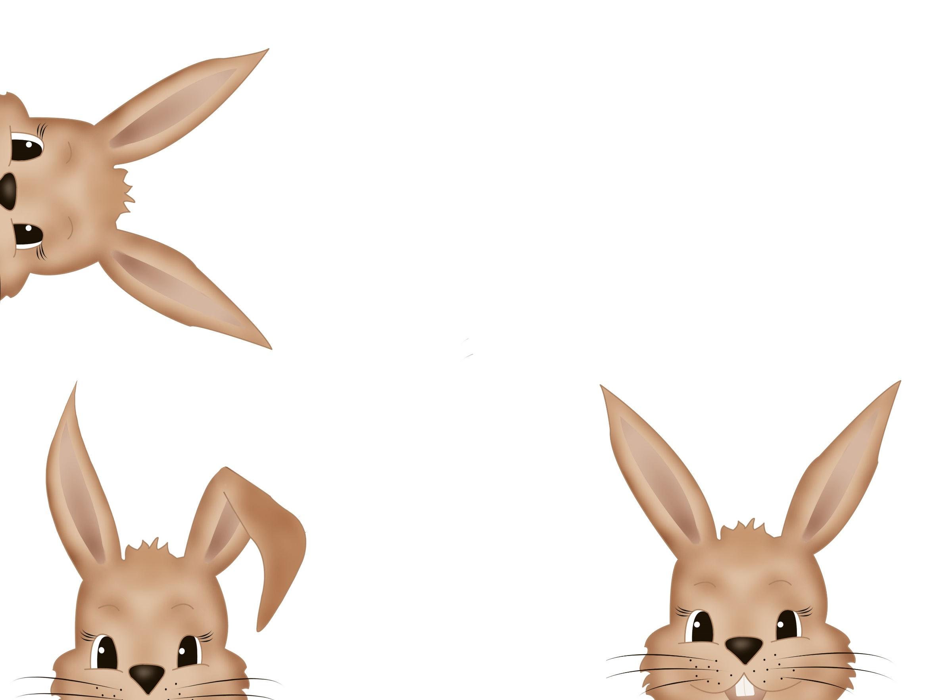
Happy Easter

Slide 8
Celebrate this Easter with a heart filled with peace, joy and cheer!
Have A Happy Easter

Slide 9
Have a blessed Easter
To a wonderful friend!

Slide 10
We are egg-cited about Easter

Slide 11
EASTER
IS THE ONLY TIME OF YEAR WHE IT'S PERFECTLY SAFE TO PUT ALL YOUR
EGGS
IN ONE
BASKET.

Slide 12
EASTER EGG HUNT

Slide 13
The great gift of Easter is hope.

Slide 14
EASTER
IS THE
DEMONSTRATION
OF GOD THAT
LIFE
IS ESSENTIALLY
SPIRTUAL
AND TIMELESS

Slide 15
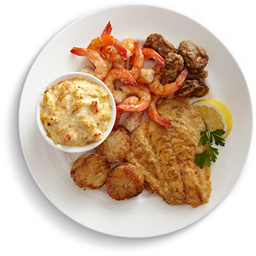
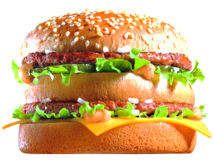
MENU 1
MENU 2
MENU 3
ITEM
ITEM
ITEM
ITEM
ITEM
ITEM
PRICE
PRICE
PRICE
PRICE
PRICE
PRICE
ITEM
ITEM
ITEM
ITEM
ITEM
ITEM
PRICE
PRICE
PRICE
PRICE
PRICE
PRICE
ITEM
ITEM
ITEM
ITEM
ITEM
ITEM
PRICE
PRICE
PRICE
PRICE
PRICE
PRICE

Slide 16
09
Days Left

Slide 17
03
Days Left

Slide 18
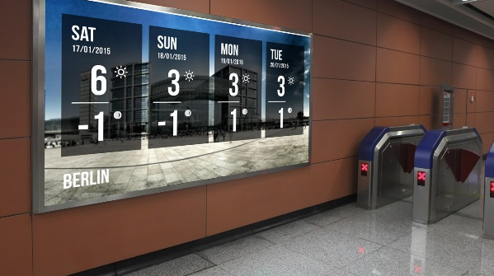
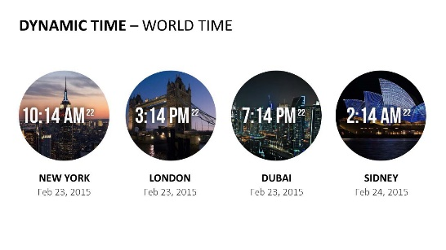
Do More With PresentationPoint Products
Real-time weather and forecasts
Add a clock or countdown to your presentations
Live RSS feed in your PowerPoint
Notes:
18

