Slide 1
PowerPoint Templates provided by PresentationPoint.com
Software solutions for digital signage and data driven presentations
www.PresentationPoint.com

Slide 2
COPYRIGHT NOTICE:
You are allowed to use these templates in your own organization and modify them as you like. You cannot sell or give them to others. Instead, direct them to PresentationPoint.com to download their own copy.

Slide 3
USING THIS TEMPLATE FOR DIGITAL SIGNAGE?
Check out iPoint
THE POWERPOINT DIGITAL SIGNAGE SOLUTION

Slide 4
NEED TO CONNECT THIS TEMPLATE TO DATA?
Check out DataPoint
OUR POWERPOINT
ADD-ON FOR DATA

Slide 5
WANT TO ADD WEATHER AND NEWS TO YOUR TEMPLATE?
Try Dynamic Elements
POWERPOINT ADD-ON
FOR NEWS AND WEATHER

Slide 6
WANT TIMERS & CLOCKS
ON YOUR TEMPLATE?
Try Dynamic Time
POWERPOINT ADD-ON FOR CLOCKS, TIMERS AND COUNTDOWNS

Slide 7
MONDAY
7:30AM
5:30PM
TUESDAY
7:30AM
5:30PM
WEDNESDAY
7:30AM
5:30PM
THURSDAY
7:30AM
5:30PM
FRIDAY
7:30AM
5:30PM
SATURDAY
7:30AM
5:30PM
SUNDAY
CLOSED
TIME
1:30PM

Slide 8
OPENING HOURS
MON
7:30AM
TO
5:30PM
TUE
7:30AM
TO
5:30PM
WED
7:30AM
TO
5:30PM
THU
7:30AM
TO
5:30PM
FRI
7:30AM
TO
5:30PM
SAT
7:30AM
TO
5:30PM
SUN
CLOSED
TIME
1:30PM

Slide 9
LOGO
MON
7:30AM
5:30PM
TUE
7:30AM
5:30PM
WED
7:30AM
5:30PM
THU
7:30AM
5:30PM
FRI
7:30AM
5:30PM
SAT
7:30AM
5:30PM
SUN
CLOSED
TIME
1:30PM

Slide 10
OPENING HOURS
MON
/
7:30AM
5:30PM
TUE
/
7:30AM
5:30PM
WED
/
7:30AM
5:30PM
THU
/
7:30AM
5:30PM
FRI
/
7:30AM
5:30PM
SAT
/
7:30AM
5:30PM
SUN
/
CLOSED
TIME
1:30PM

Slide 11
MONDAY
7:30AM
5:30PM
TUESDAY
7:30AM
5:30PM
WEDNESDAY
7:30AM
5:30PM
THURSDAY
7:30AM
5:30PM
FRIDAY
7:30AM
5:30PM
SATURDAY
7:30AM
5:30PM
SUNDAY
CLOSED
TIME
1:30PM

Slide 12
SUNDAY
CLOSED
MONDAY
7:30AM
5:30PM
TUESDAY
7:30AM
5:30PM
WEDNESDAY
7:30AM
5:30PM
THURSDAY
7:30AM
5:30PM
FRIDAY
7:30AM
5:30PM
SATURDAY
7:30AM
5:30PM
TIME
1:30PM

Slide 13
Sunday
Closed
Monday
7:30am
5:30pm
Tuesday
7:30am
5:30pm
Wednesday
7:30am
5:30pm
Thursday
7:30am
5:30pm
Friday
7:30am
5:30pm
Saturday
7:30am
5:30pm
Time
1:30pm

Slide 14
SU
CLOSED
M
7:30AM
5:30PM
T
7:30AM
5:30PM
W
7:30AM
5:30PM
TH
7:30AM
5:30PM
F
7:30AM
5:30PM
S
7:30AM
5:30PM
TIME
1:30PM

Slide 15
OPENING HOURS
SUN
CLOSED
MON
7:30AM
5:30PM
TUE
7:30AM
5:30PM
WED
7:30AM
5:30PM
THU
7:30AM
5:30PM
FRI
7:30AM
5:30PM
SAT
7:30AM
5:30PM

Slide 16
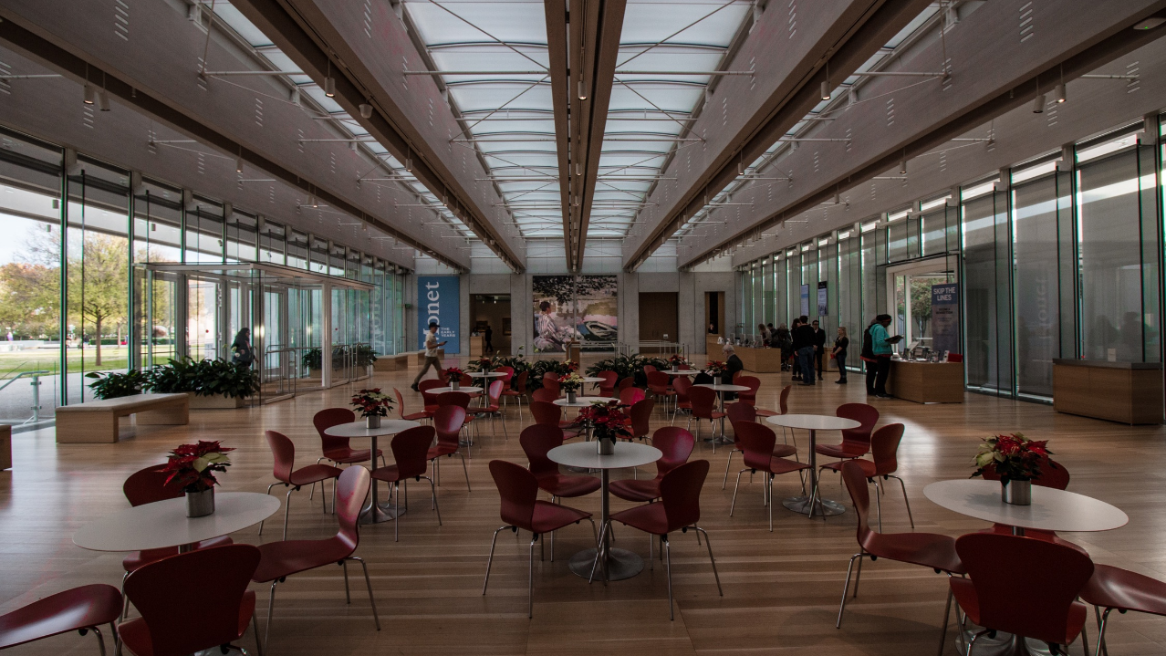
WELCOME
SUN
-
CLOSED
MON
-
7:30AM
5:30PM
TUE
-
7:30AM
5:30PM
WED
-
7:30AM
5:30PM
THU
-
7:30AM
5:30PM
FRI
-
7:30AM
5:30PM
SAT
-
7:30AM
5:30PM
TIME
1:30PM

Slide 17
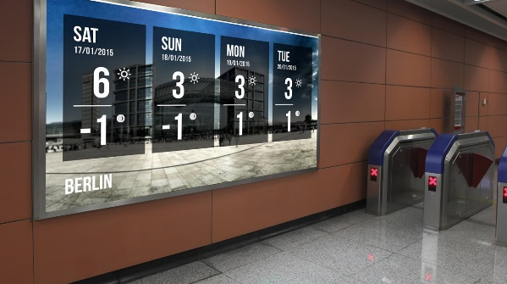
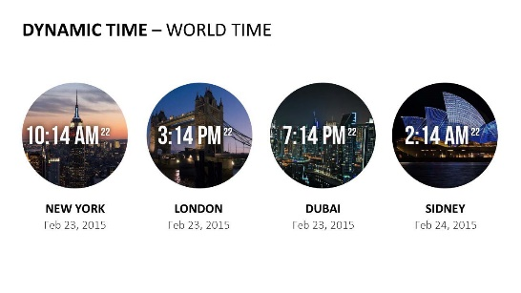
Do More With PresentationPoint Products
Real-time weather and forecasts
Add a clock or countdown to your presentations
Live RSS feed in your PowerPoint
Notes:
17

