Slide 1
PowerPoint Templates provided by PresentationPoint.com
Software solutions for digital signage and data driven presentations
www.PresentationPoint.com

Slide 2
COPYRIGHT NOTICE:
You are allowed to use these templates in your own organization and modify them as you like. You cannot sell or give them to others. Instead, direct them to PresentationPoint.com to download their own copy.

Slide 3
USING THIS TEMPLATE FOR DIGITAL SIGNAGE?
Check out iPoint
THE POWERPOINT DIGITAL SIGNAGE SOLUTION

Slide 4
NEED TO CONNECT THIS TEMPLATE TO DATA?
Check out DataPoint
OUR POWERPOINT
ADD-ON FOR DATA

Slide 5
WANT TO ADD WEATHER AND NEWS TO YOUR TEMPLATE?
Try Dynamic Elements
POWERPOINT ADD-ON
FOR NEWS AND WEATHER

Slide 6
WANT TIMERS & CLOCKS
ON YOUR TEMPLATE?
Try Dynamic Time
POWERPOINT ADD-ON FOR CLOCKS, TIMERS AND COUNTDOWNS

Slide 7
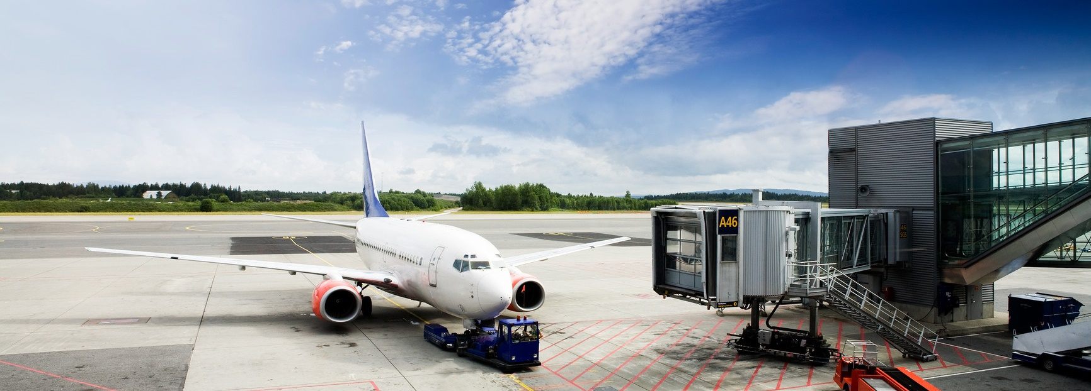
Welcome to Airport
Have a nice flight !
YOUR LOGO

Slide 8
Arrivals
09:41
STA | Flight | From | Gate | Status
09:00 | WN 269 | Denver | A07 | Landed at 09:07
09:00 | FL 2269 | Denver | A07 | Landed at 09:07
09:10 | WN 498 | San Diego | B03 | Landed at 09:18
09:15 | WN 3145 | Las Vegas | A01 | Cancelled
09:30 | WN 612 | Las Vegas | A45 | Expected at 09:57
09:45 | WN 4010 | Los Angeles | B02 | On time
09:45 | WN 1173 | Phoenix | B11 | Cancelled
10:10 | DL 2120 | Atlanta | A12 | Expected at 09:51
10:10 | KL 5744 | Atlanta | A12 | Expected at 09:51
10:10 | WN 678 | Wichita | C08 | Expected at 10:07
Display live arrival information on your monitor using DataPoint
You can remove this note
Please do not leave your baggage unattended
Notes:
8

Slide 9
Departures
09:41
STD | Flight | To | Check in | Status
09:00 | WN 269 | Denver | A07 | Departed at 09:08
09:00 | FL 2269 | Denver | A07 | Departed at 09:08
09:10 | WN 498 | San Diego | B03 | Departed at 09:23
09:15 | WN 3145 | Las Vegas | A01 | Cancelled
09:30 | WN 612 | Las Vegas | A45 | Gate closed
09:45 | WN 4010 | Los Angeles | B02 | Gate closed
09:45 | WN 1173 | Phoenix | B11 | Final call
10:10 | DL 2120 | Atlanta | A12 | Gate open
10:10 | KL 5744 | Atlanta | A12 | Gate open
10:10 | WN 678 | Wichita | C08 | On time
Display live departure information on your monitor using DataPoint
You can remove this note
Please do not leave your baggage unattended
Notes:
9

Slide 10
Promotions and advertising on your displays by DataPoint
You can remove this note
YOUR LOGO
Food
Hungry for a real hamburger?
Product information
$3.99
Product description here
Product description here
Product description here
Notes:
10

Slide 11
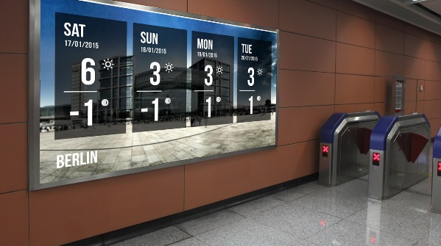
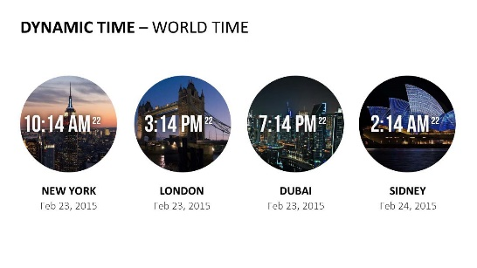
Do More With PresentationPoint Products
Real-time weather and forecasts
Add a clock or countdown to your presentations
Live RSS feed in your PowerPoint
Notes:
11

