Slide 1
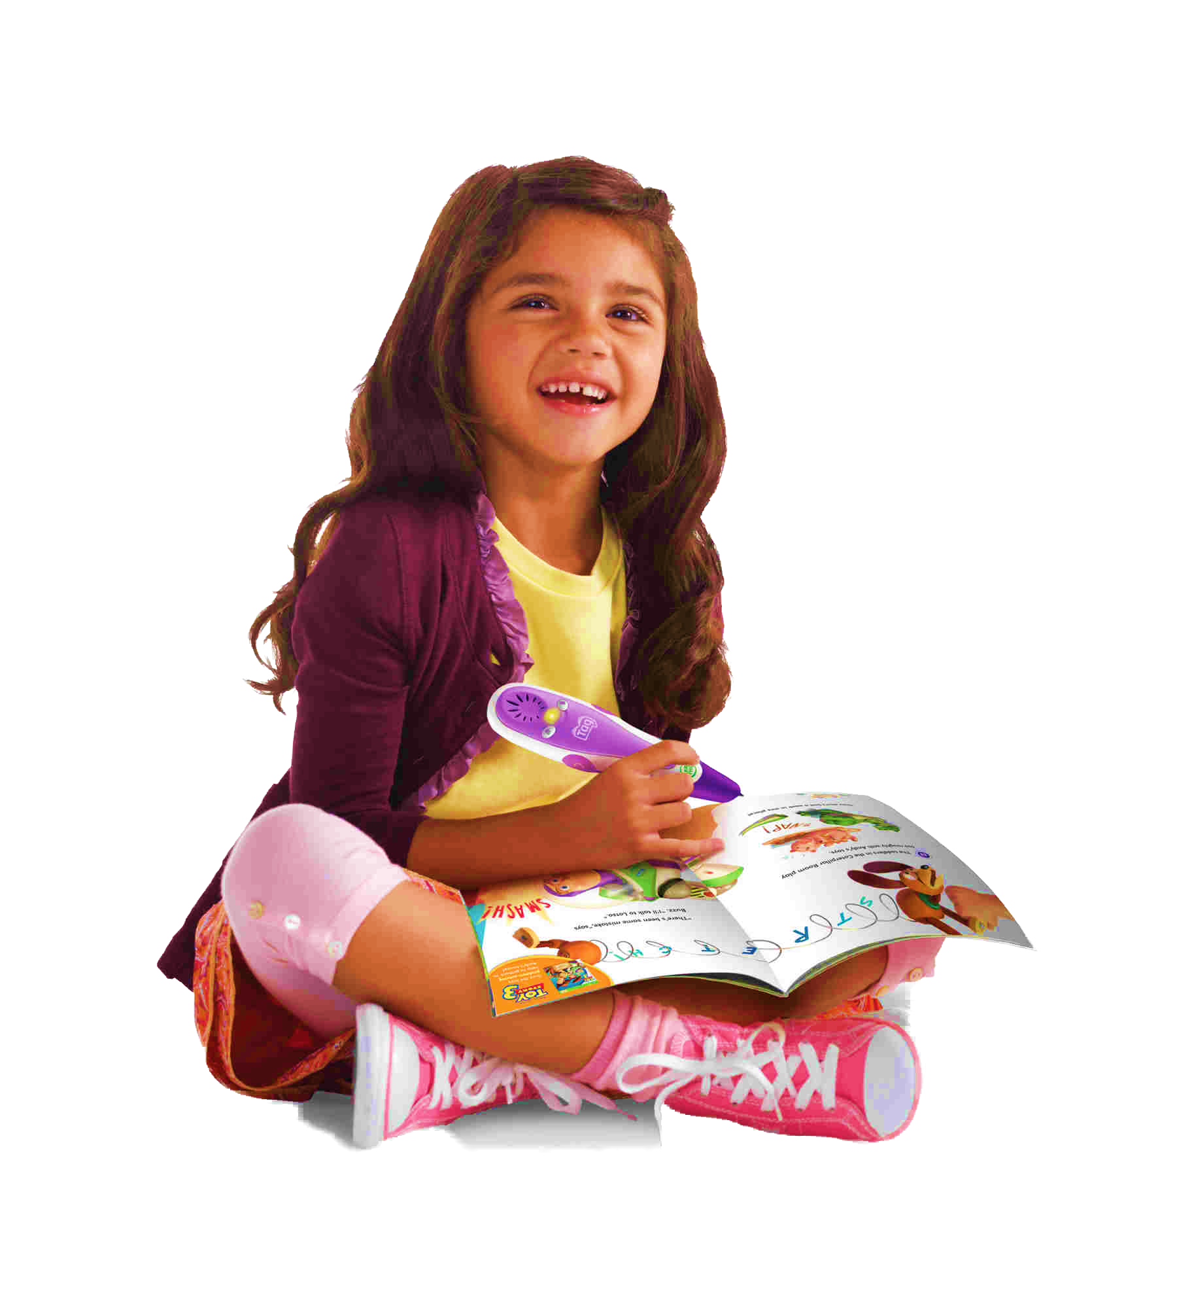
A
KIDSPLACE
D
AN INSPIRED LIFE BEGINS
c
Our cooperative learning community brings together children, parents, and teachers in meaningful play. We develop collaborative relationships and explore environments, experiences, and activities that encourage curiosity and wonder. We value who children are, celebrate their unique gifts, believe in their capabilities, encourage their interests, and honor their feelings and ideas.
F
Notes:
https://www.cleanpng.com/png-kid-png-59084

Slide 2
F
KIDSPLACE
OUR SCHOOL
c
Our cooperative learning community brings together children, parents, and teachers in meaningful play. We develop collaborative relationships and explore environments, experiences, and activities that encourage curiosity and wonder. We value who children are, celebrate their unique gifts, believe in their capabilities, encourage their interests, and honor their feelings and ideas.
A
Notes:
https://www.cleanpng.com/png-school-uniform-student-pre-school-child-kids-1054898

Slide 3
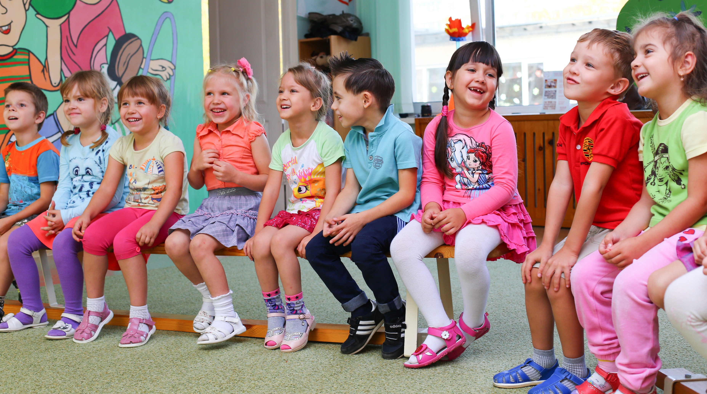
A
KIDSPLACE
KIDSPLACE
LEARNING COOPERATIVELY
Parents take an active role in the classroom and are involved in all aspects of their child's learning experience. As a result, the relationship between families and our school extend far beyond the playground. The sense of community between teachers, parents, and children creates a nurturing, caring space for young minds to grow, tender hearts to open and an inspired life to begin.
F
Notes:
https://pixabay.com/photos/kindergarten-clown-garden-animator-2204239/

Slide 4
F
KIDSPLACE
LEARNING THROUGH PLAY
The joy and instinctive sense of wonder and delight that play brings validates it as the most central, natural, and important aspect of childhood. Believing in a play-based philosophy is simply accepting that children naturally engage in and enjoy play as a means of learning on their terms, in their own way, and at their own pace.
D
Notes:
4.https://unsplash.com/photos/WA2EE7YtzC4
5.https://unsplash.com/photos/1RFxDE9fwNU

Slide 5
KIDSPLACE
KINDERGARTEN
The learning environment invites the children to participate in concrete experiences that help them learn concepts and develop academic skills while encouraging curiosity and exploration. Our program offers a balance of cognitive work and creative play.
Notes:
https://unsplash.com/photos/yn1CwaDh18E

Slide 6
A
KIDSPLACE
ENROLL
TODAY
Thanks for your interest in our Kids Place community! We know you may have more questions about enrolling at our school! Please email us at info@kidsplace.com
c
F
Notes:
7.https://image.shutterstock.com/z/stock-photo-group-of-kindergarten-kids-friends-arm-around-sitting-and-smiling-fun-636281354.jpg
8.https://www.cleanpng.com/png-pre-school-student-project-based-learning-educatio-2678911

Slide 7
F
KIDSPLACE
PRESCHOOL
We know that children learn best at this age by doing. They are explorers actively interested in learning about the world around them and constructing new understanding through experimentation and play. We support this by providing classrooms with engaging learning environments. These include: dramatic play, writing workshop, art studio, painting easels, sensory tables, woodworking, science inquiry, block building, loft, light zone, reading nook, obstacle course, cooking center, outdoor playground, and garden. Equipment and materials are flexible and open ended to encourage individual choice and critical thinking. We strive to encourage life-long wonder!
D
Notes:
4.https://unsplash.com/photos/WA2EE7YtzC4
https://unsplash.com/photos/0DPyb8t_KfI

Slide 8
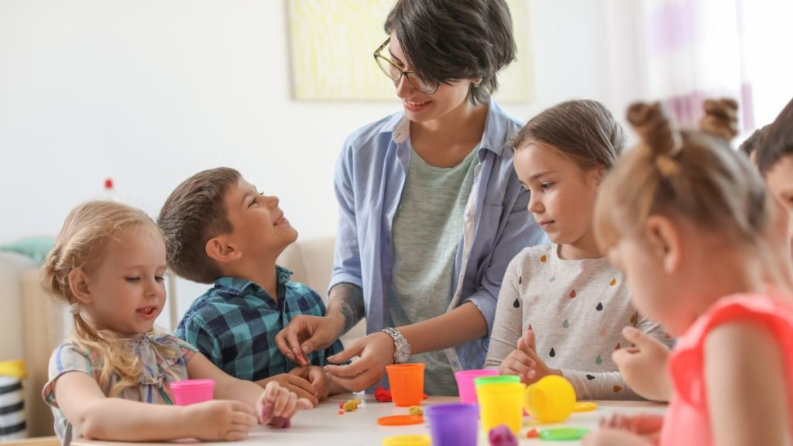
KIDSPLACE
D
MEET OUR TEACHERS
Make an appointment and meet the future teachers of your child.
F
Notes:
https://stock.adobe.com/images/young-woman-playing-with-little-children-indoors/212305530

Slide 9
F
KIDSPLACE
THANKS FOR
WATCHING
Kids Place provides safe, nurturing, and flexible learning environments that promote the social, emotional, physical, and cognitive development of young children.
D
Notes:
11.https://www.pexels.com/photo/boy-child-childhood-class-207653/
12.https://www.pexels.com/photo/girls-on-desk-looking-at-notebook-159823/

Slide 10
A
KIDSPLACE
KIDSPLACE
Our cooperative learning community brings together children, parents, and teachers in meaningful play. We develop collaborative relationships and explore environments, experiences, and activities that encourage curiosity and wonder. We value who children are, celebrate their unique gifts, believe in their capabilities, encourage their interests, and honor their feelings and ideas.
c
F
Notes:
https://ak9.picdn.net/shutterstock/videos/5251799/thumb/11.jpg

