Slide 1
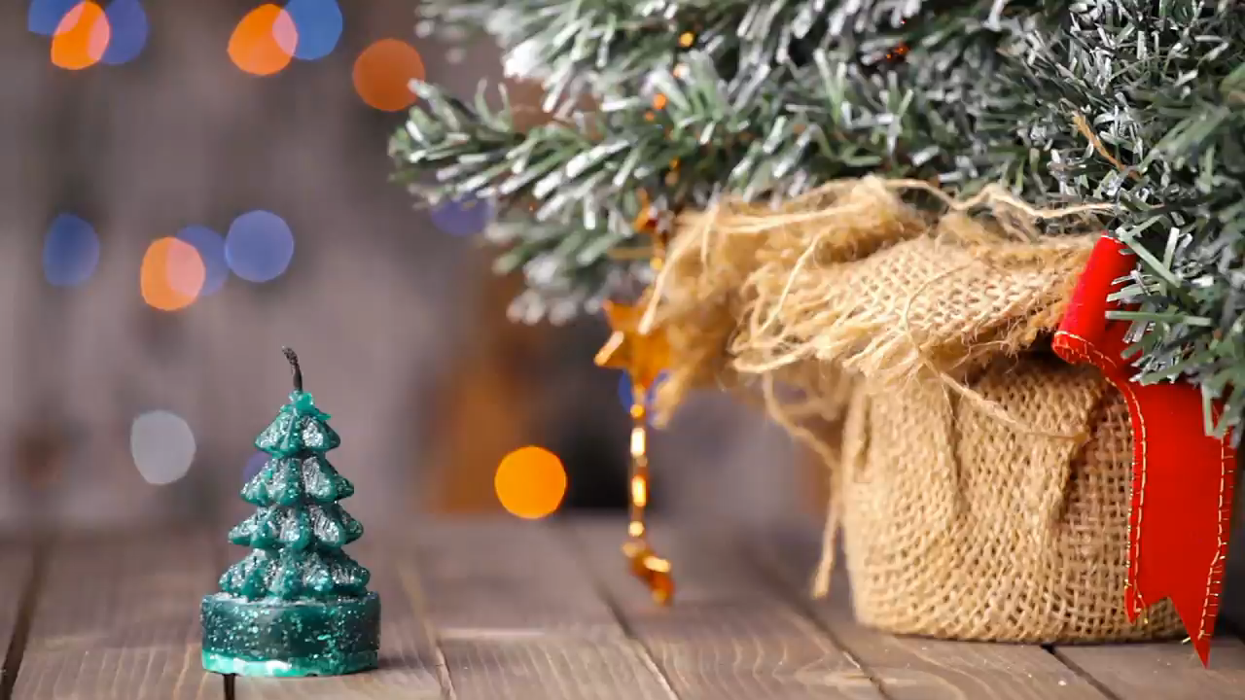
Only...
16
07
56
18
days
hours
mins
secs
Until Christmas!

Slide 2
CHRISTMAS COUNTDOWN!
16
07
56
18
days
hours
mins
secs
yourwebsite.com/shop

Slide 3
CHRISTMAS COMING!!
16
07
56
22
DAYS
HOURS
MINS
SECS
yourwebsite.com/shop

