Slide 1
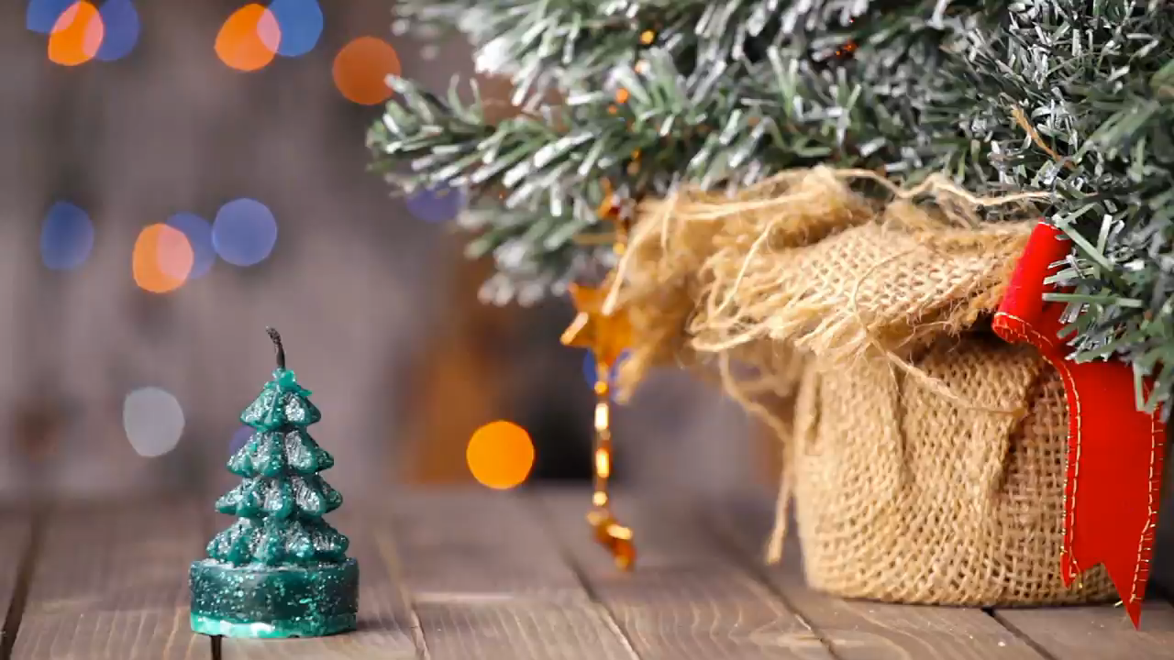
Only...
23
13
41
05
days
hours
mins
secs
Until Christmas!

Slide 2
CHRISTMAS COUNTDOWN!
23
13
41
02
days
hours
mins
secs
yourwebsite.com/shop

Slide 3
CHRISTMAS COMING!!
23
13
41
02
DAYS
HOURS
MINS
SECS
yourwebsite.com/shop

