Slide 1
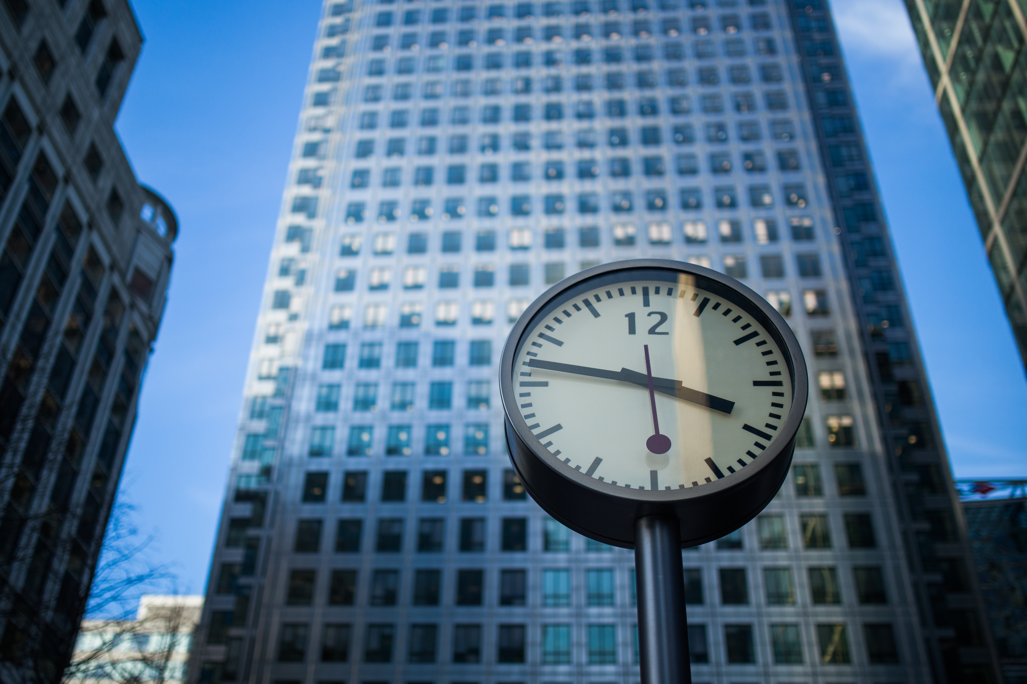
Tuesday, July 12, 2016
4:44:56 PM
TIME IN NYC
10:44:57 AM

