Slide 1
Notes:
HANDOUT: https://chabosinc-my.sharepoint.com/:b:/g/personal/cbosse_chabos_ca/ESQyNS8qoqBLtBtZ7ijuXYsBmnexpx6vtPDxvF7S23GJzw?e=zVcV5K

Slide 2
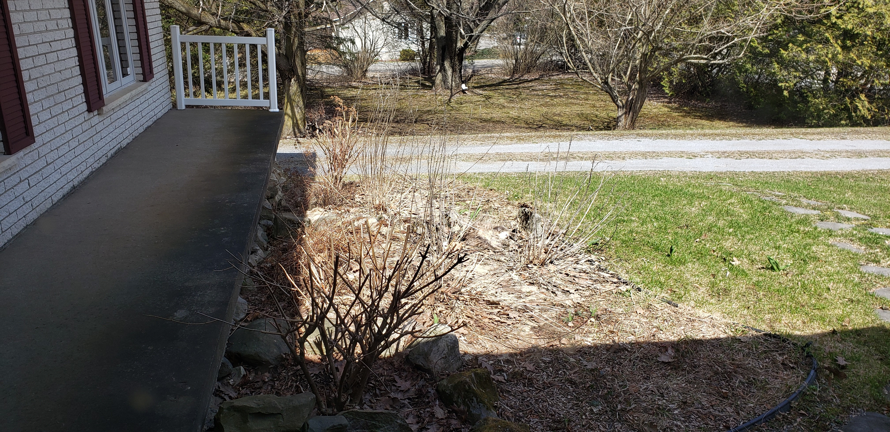
Where is Minette?

Slide 3
Here?

Slide 4
There?

Slide 5
Right here!!

