Slide 1
PowerPoint Templates provided by PresentationPoint.com
Software solutions for digital signage and data driven presentations
www.PresentationPoint.com

Slide 2
COPYRIGHT NOTICE:
You are allowed to use these templates in your own organization and modify them as you like. You cannot sell or give them to others. Instead, direct them to PresentationPoint.com to download their own copy.

Slide 3
USING THIS TEMPLATE FOR DIGITAL SIGNAGE?
Check out iPoint
THE POWERPOINT DIGITAL SIGNAGE SOLUTION

Slide 4
NEED TO CONNECT THIS TEMPLATE TO DATA?
Check out DataPoint
OUR POWERPOINT
ADD-ON FOR DATA

Slide 5
WANT TO ADD WEATHER AND NEWS TO YOUR TEMPLATE?
Try Dynamic Elements
POWERPOINT ADD-ON
FOR NEWS AND WEATHER

Slide 6
WANT TIMERS & CLOCKS
ON YOUR TEMPLATE?
Try Dynamic Time
POWERPOINT ADD-ON FOR CLOCKS, TIMERS AND COUNTDOWNS

Slide 7
Only...
67
19
05
39
days
hours
mins
secs
Until Christmas!

Slide 8
CHRISTMAS COUNTDOWN!
67
19
05
39
days
hours
mins
secs
yourwebsite.com/shop

Slide 9
CHRISTMAS COMING!!
67
19
05
39
DAYS
HOURS
MINS
SECS
yourwebsite.com/shop

Slide 10
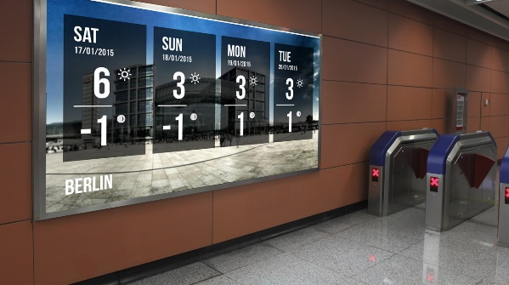
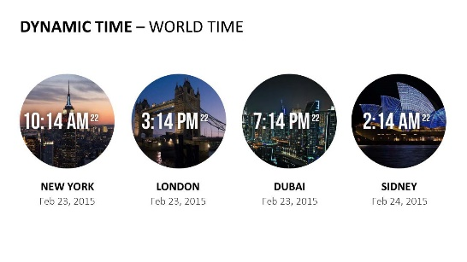
Do More With PresentationPoint Products
Real-time weather and forecasts
Add a clock or countdown to your presentations
Live RSS feed in your PowerPoint
Notes:
10

